Slide 1
Chapter 6
Thermochemistry

Slide 2
6.1 The Nature of Energy
6.2 Enthalpy and Calorimetry
6.3 Hess’s Law
6.4 Standard Enthalpies of Formation

Slide 3
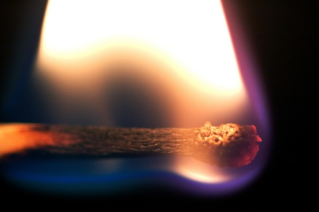
TWO Trends in Nature
Order → Disorder
→ →
High energy → Low energy
→

Slide 4
Energy
Capacity to do work or to produce heat.
Law of conservation of energy – energy can be converted from one form to another but can be neither created nor destroyed.
The total energy content of the universe is constant.

Slide 5
Energy
Potential energy – energy due to position or composition.
Kinetic energy – energy due to motion of the object and depends on the mass of the object and its velocity.

Slide 6
Energy
Heat involves the transfer of energy between two objects due to a temperature difference.
Work – force acting over a distance.
Energy is a state function; work and heat are not:
State Function – property that does not depend in any way on the system’s past or future (only depends on present state).

Slide 7
Chemical Energy
System – part of the universe on which we wish to focus attention.
Surroundings – include everything else in the universe.

Slide 8
Chemical Energy
Endothermic Reaction:
Heat flow is into a system.
Absorb energy from the surroundings.
Exothermic Reaction:
Energy flows out of the system.
Energy gained by the surroundings must be equal to the energy lost by the system.

Slide 9
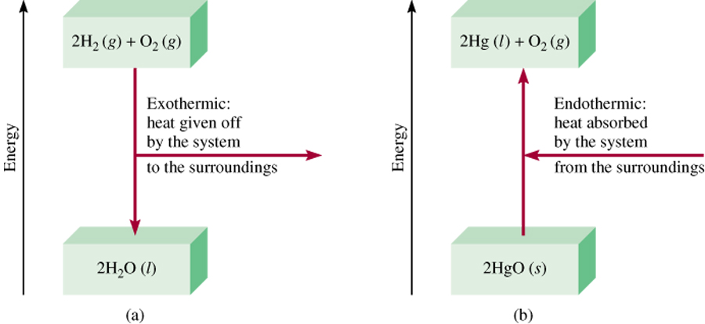
Enthalpy (H) is used to quantify the heat flow into (or out of) a system in a process that occurs at constant pressure.
ΔH = H (products) – H (reactants)
ΔH = heat given off or absorbed during a reaction at constant pressure
H_{products} < H_{reactants}
H_{products} > H_{reactants}
ΔH < 0
ΔH > 0
6.4

Slide 10
Concept Check
Classify each process as exothermic or endothermic. Explain. The system is underlined in each example.
Your hand gets cold when you touch ice.
The ice gets warmer when you touch it.
Water boils in a kettle being heated on a stove.
Water vapor condenses on a cold pipe.
Ice cream melts.
Exo
Endo
Endo
Exo
Endo
Notes:
Exothermic (heat energy leaves your hand and moves to the ice)
Endothermic (heat energy flows into the ice)
Endothermic (heat energy flows into the water to boil it)
Exothermic (heat energy leaves to condense the water from a gas to a liquid)
Endothermic (heat energy flows into the ice cream to melt it)

Slide 11
Internal Energy
Law of conservation of energy is often called the first law of thermodynamics.
Internal energy (E) of a system is the sum of the kinetic and potential energies of all the “particles” in the system.
To change the internal energy of a system: ΔE = q + w
q represents heat
w represents work

Slide 12
Exercise
Consider the combustion of propane:
C₃H₈(g) + 5O₂(g) → 3CO₂(g) + 4H₂O(l)
ΔH = –2221 kJ
Assume that all of the heat comes from the combustion of propane. Calculate ΔH in which 5.00 g of propane is burned in excess oxygen at constant pressure.
–252 kJ
Notes:
(5.00 g C₃H₈)(1 mol / 44.094 g C₃H₈)(-2221 kJ / mol C₃H₈)
ΔH = -252 kJ

Slide 13
Calorimetry
Science of measuring heat
Specific heat capacity (c or s):
The energy required to raise the temperature of one gram of a substance by one degree Celsius.
Molar heat capacity:
The energy required to raise the temperature of one mole of substance by one degree Celsius.

Slide 14
Calorimetry
If two reactants at the same temperature are mixed and the resulting solution gets warmer, this means the reaction taking place is exothermic.
An endothermic reaction cools the solution.

Slide 15
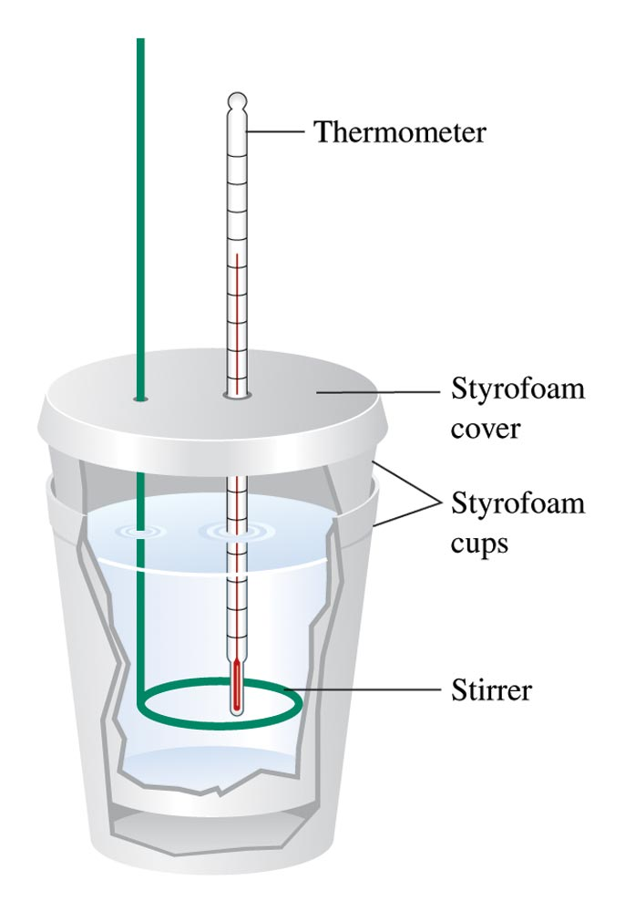
A Coffee–Cup Calorimeter Made of Two Styrofoam Cups

Slide 16
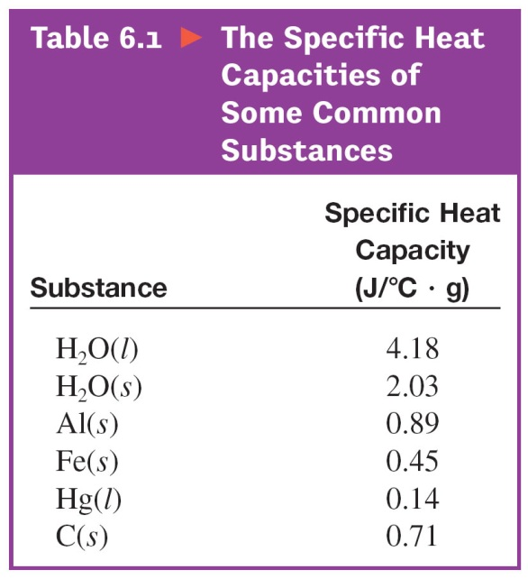
Calorimetry
Energy released (heat) = m × c × ΔT
*on formula sheet
c (sometimes s) = specific heat capacity (J/°C·g)
m = mass (g)
ΔT = change in temperature (°C)

Slide 17
Concept Check
A 100.0 g sample of water at 90.°C is added to a 500.0 g sample of water at 10.°C.
The final temperature of the water is:
a) Between 50°C and 90°C
b) 50°C
c) Between 10°C and 50°C
Calculate the final temperature of the water.
23°C
Notes:
The correct answer is c). The final temperature of the water is 23°C.
(100.0 g)(4.18 J/°C·g)(90 - T_{f}.) = (500.0 g)(4.18 J/°C·g)(T_{f} – 10.)
T_{f} = 23°C

Slide 18
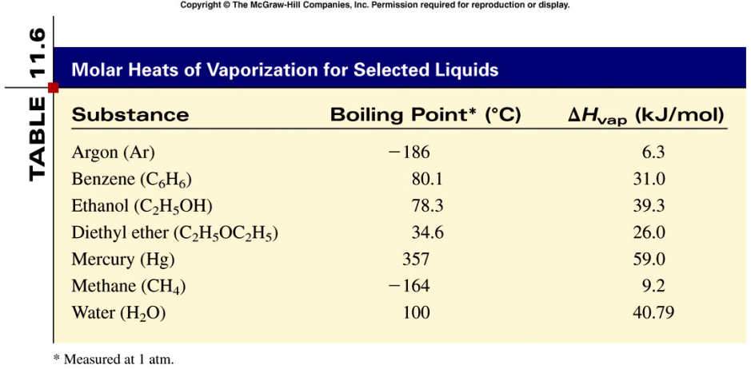
Phase Changes
The boiling point is the temperature at which the (equilibrium) vapor pressure of a liquid is equal to the external pressure. (normal B.P. is at 1 atm)
Heat of vaporization is the energy required to convert one mole of a substance from liquid to gas.
11.8

Slide 19
Molar heat of fusion (ΔH_{fus}) is the energy required to melt 1 mole of a solid substance (solid to liquid).
11.8

Slide 20
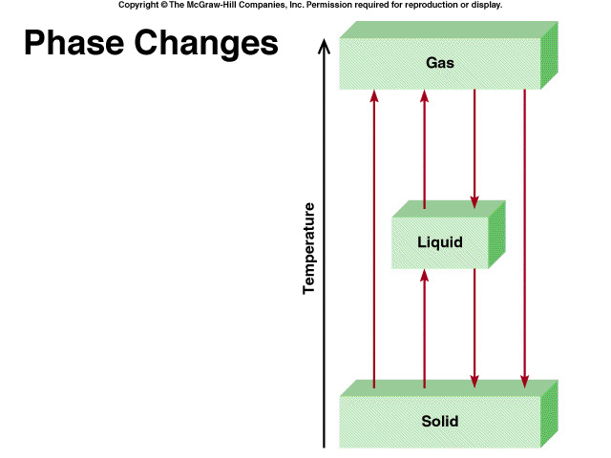
H₂O (s) H₂O (l)
The melting point of a solid or the freezing point of a liquid is the temperature at which the solid and liquid phases coexist in equilibrium
Melting
Freezing
11.8

Slide 21
H₂O (s) H₂O (g)
Molar heat of sublimation (ΔH_{sub}) is the energy required to sublime 1 mole of a solid.
Sublimation
Deposition
ΔH_{sub =} ΔH_{fus} + ΔH_{vap}
( Hess’s Law)
11.8

Slide 22
11.8

Slide 23
Sample Problem
How much heat is required to change 36 g of H₂O from -8 deg C to 120 deg C?
Step 1: Heat the ice Q=mcΔT
Q = 36 g x 2.06 J/g deg C x 8 deg C = 593.28 J = 0.59 kJ
Step 2: Convert the solid to liquid ΔH _{fusion}
Q = 2.0 mol x 6.01 kJ/mol = 12 kJ
Step 3: Heat the liquid Q=mcΔT
Q = 36g x 4.184 J/g deg C x 100 deg C = 15063 J = 15 kJ

Slide 24
Sample Problem
How much heat is required to change 36 g of H₂O from -8 deg C to 120 deg C?
Step 4: Convert the liquid to gas ΔH _{vaporization}
Q = 2.0 mol x 44.01 kJ/mol = 88 kJ
Step 5: Heat the gas Q=mcΔT
Q = 36 g x 2.02 J/g deg C x 20 deg C = 1454.4 J = 1.5 kJ
Now, add all the steps together
0.59 kJ + 12 kJ + 15 kJ + 88 kJ + 1.5 kJ = 118 kJ

Slide 25
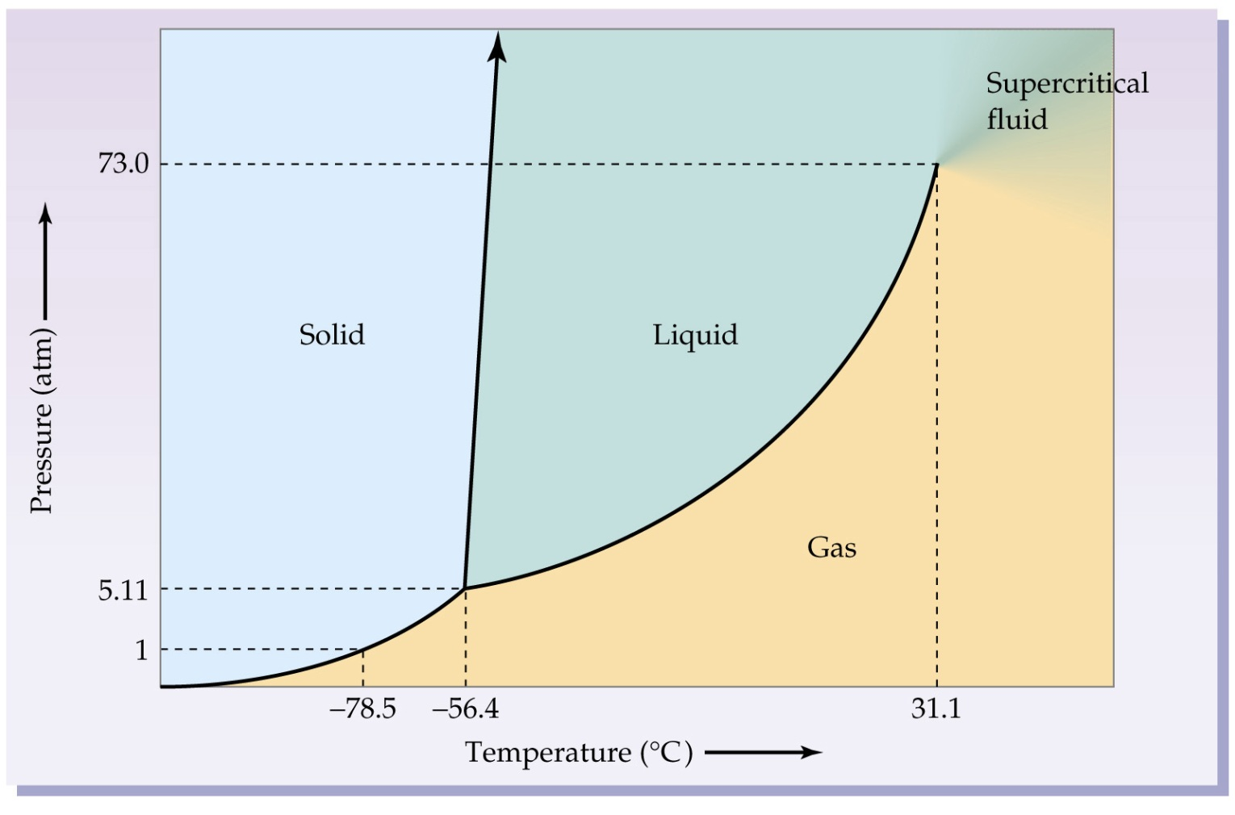
Where’s Waldo?
Can you find…
The Triple Point?
Where fusion occurs?
Where vaporization occurs?
Melting point (at 1 atm)?
Boiling point (at 6 atm)?
Phase Diagrams are NO LONGER on the AP Exam
Carbon Dioxide

Slide 26
In going from a particular set of reactants to a particular set of products, the change in enthalpy is the same whether the reaction takes place in one step or in a series of steps.

Slide 27
N₂(g) + 2O₂(g) → 2NO₂(g) ΔH₁ = 68 kJ
This reaction also can be carried out in two distinct steps, with enthalpy changes designated by ΔH₂ and ΔH₃.
N₂(g) + O₂(g) → 2NO(g) ΔH₂ = 180 kJ
2NO(g) + O₂(g) → 2NO₂(g) ΔH₃ = – 112 kJ
N₂(g) + 2O₂(g) → 2NO₂(g) ΔH₂ + ΔH₃ = 68 kJ
ΔH₁ = ΔH₂ + ΔH₃ = 68 kJ

Slide 28
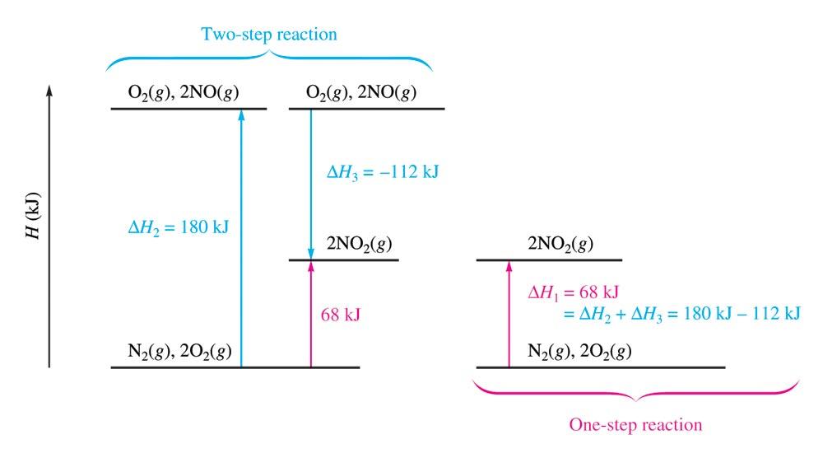
The Principle of Hess’s Law

Slide 30
Characteristics of Enthalpy Changes
If a reaction is reversed, the sign of ΔH is also reversed.
The magnitude of ΔH is directly proportional to the quantities of reactants and products in a reaction. ΔH values are given per mole. To find the total energy change, you must multiply by the number of moles (according to the balanced equation).

Slide 31
Example
Consider the following data:
Calculate ΔH for the reaction

Slide 32
Problem-Solving Strategy
Work backward from the required reaction, using the reactants and products to decide how to manipulate the other given reactions at your disposal.
Reverse any reactions as needed to give the required reactants and products.
Multiply reactions to give the correct numbers of reactants and products.

Slide 33
Example
Reverse the two reactions:
Desired reaction:

Slide 34
Example
Multiply reactions to give the correct numbers of reactants and products:
4( ) 4( )
3( ) 3( )
Desired reaction:

Slide 35
Example
Final reactions:
Desired reaction:
ΔH = +1268 kJ

Slide 36
Standard Enthalpy of Formation (ΔH_{f}°)
Change in enthalpy that accompanies the formation of one mole of a compound from its elements with all substances in their standard states.

Slide 37
Conventional Definitions of Standard States
For a Compound
For a gas, pressure is exactly 1 atm.
For a solution, concentration is exactly 1 M.
Pure substance (liquid or solid)
For an Element
The form [N₂(g), K(s)] in which it exists at 1 atm and 25°C.
Heat of formation is zero.

Slide 38
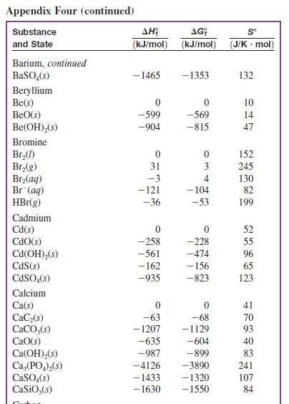
Thermodynamics Table, Appendix 4

Slide 39
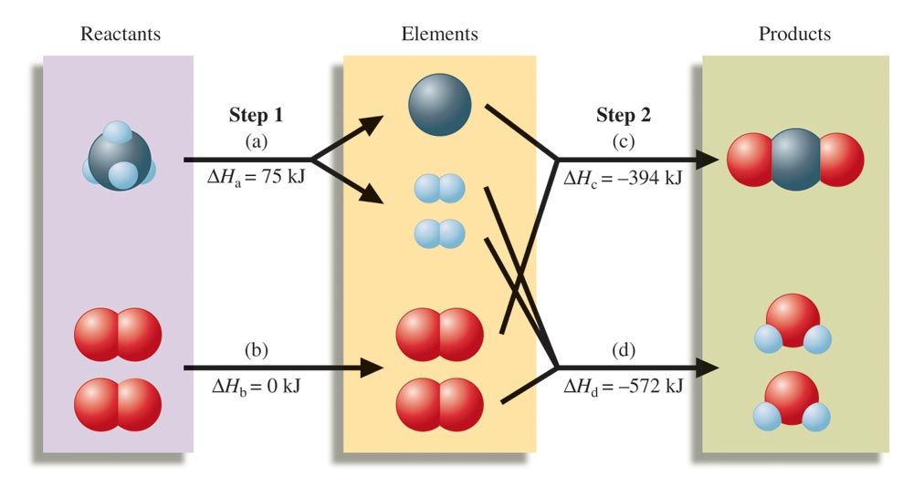
A Schematic Diagram of the Energy Changes for the Reaction CH₄(g) + 2O₂(g) → CO₂(g) + 2H₂O(l)
ΔH°_{reaction} = –(–75 kJ) + 0 + (–394 kJ) + (–572 kJ) = –891 kJ

Slide 40
Problem-Solving Strategy: Enthalpy Calculations
When a reaction is reversed, the magnitude of ΔH remains the same, but its sign changes.
When the balanced equation for a reaction is multiplied by an integer, the value of ΔH for that reaction must be multiplied by the same integer.

Slide 41
Problem-Solving Strategy: Enthalpy Calculations
The change in enthalpy for a given reaction can be calculated from the enthalpies of formation of the reactants and products:
ΔH°_{rxn} = ΣΔH_{f}°_{(products)} - ΣΔH_{f}°_{(reactants)}
*on formula sheet
4. Elements in their standard states are not included in the ΔH_{reaction} calculations because ΔH_{f}° for an element in its standard state is zero.

Slide 42
Exercise
Calculate ΔH° for the following reaction:
2Na(s) + 2H₂O(l) → 2NaOH(aq) + H₂(g)
Given the following information:
ΔH_{f}° (kJ/mol)
Na(s) 0
H₂O(l) –286
NaOH(aq) –470
H₂(g) 0
ΔH° = –368 kJ
Notes:
[2(–470) + 0] – [0 + 2(–286)] = –368 kJ
ΔH = –368 kJ

Slide 43
Chemistry in Action:
Fuel Values of Foods and Other Substances
C₆H₁₂O₆ (s) + 6O₂ (g) 6CO₂ (g) + 6H₂O (l) ΔH = -2801 kJ/mol
1 cal = 4.184 J
1 Cal = 1000 cal = 4184 J

Slide 44
Chapter 17
Spontaneity, Entropy, and Free Energy

Slide 45
17.1 Spontaneous Processes and Entropy
17.2 Entropy and the Second Law of Thermodynamics
17.3 The Effect of Temperature on Spontaneity
17.4 Free Energy
17.5 Entropy Changes in Chemical Reactions
17.6 Free Energy and Chemical Reactions
17.7 The Dependence of Free Energy on Pressure
17.8 Free Energy and Equilibrium
10.8 Vapor Pressure and Changes of State

Slide 46
Spontaneous Processes and Entropy
Thermodynamics lets us predict whether a process will occur but NOT how fast it will happen
A spontaneous process is one that occurs without outside intervention. As long as the activation energy is supplied, the reaction will proceed forward.

Slide 47
Entropy (S)
The driving force for a spontaneous process is an increase in the entropy of the universe.
A measure of molecular randomness or disorder.

Slide 48
Positional Entropy
A gas expands into a vacuum because the expanded state has the highest positional probability of states available to the system.
Therefore: S_{solid} < S_{liquid} << S_{gas}

Slide 49
Concept Check
Predict the sign of ΔS for each of the following, and explain:
The evaporation of alcohol
The freezing of water
Compressing an ideal gas at constant temperature
Heating an ideal gas at constant pressure
Dissolving NaCl in water
+
–
–
+
+
Notes:
a) + (a liquid is turning into a gas)
b) - (more order in a solid than a liquid)
c) - (the volume of the container is decreasing)
d) + (the volume of the container is increasing)
e) + (there is less order as the salt dissociates and spreads throughout the water)

Slide 50
Second Law of Thermodynamics
In any spontaneous process there is always an increase in the entropy of the universe.
The entropy of the universe is increasing.
The total energy of the universe is constant, but the entropy is increasing.
S_{universe} = ΔS_{system} + ΔS_{surroundings}

Slide 51
Third Law of Thermodynamics
The entropy of a perfect crystal at 0 K is zero.
The entropy of a substance increases with temperature.

Slide 52
Standard Entropy Values (S°)
Represent the increase in entropy that occurs when a substance is heated from 0 K to 298 K at 1 atm pressure.
ΔS°_{reaction} = ΣS°_{products} – ΣS°_{reactants}
*on formula sheet

Slide 53
Exercise
Calculate ΔS° for the following reaction:
2Na(s) + 2H₂O(l) → 2NaOH(aq) + H₂(g)
Given the following information:
S° (J/K·mol)
Na(s) 51
H₂O(l) 70
NaOH(aq) 50
H₂(g) 131
ΔS°= –11 J/K
Notes:
[2(50) + 131] – [2(51) + 2(70)] = –11 J/K
ΔS°= –11 J/K

Slide 54
Standard Free Energy Change (ΔG°)
The change in free energy that will occur if the reactants in their standard states are converted to the products in their standard states.
ΔG°_{reaction} = ΣG°_{products} – ΣG°_{reactants}
*on formula sheet

Slide 55
Free Energy (G)
Gibbs Free Energy is the total energy (both H and S) that is available to do work
A process (at constant T and P) is spontaneous in the direction in which the free energy decreases.
Negative ΔG means positive ΔS_{univ}.
ΔG = ΔH – TΔS (at constant T and P)
*on formula sheet

Slide 56
Effect of ΔH and ΔS on Spontaneity

Slide 57
Recap: Signs of Thermodynamic Values
 | Negative | Positive
Enthalpy (ΔH) | Exothermic | Endothermic
Entropy (ΔS) | Less disorder | More disorder
Gibbs Free Energy (ΔG) | Spontaneous | Not spontaneous

Slide 58
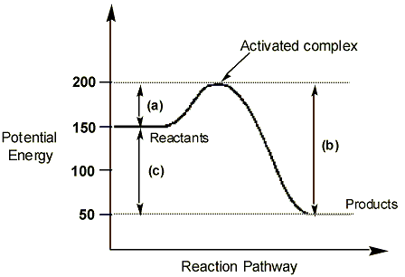
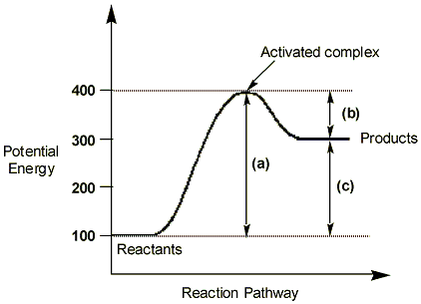
Energy Diagrams
Exothermic
Endothermic
Activation energy (Ea) for the forward reaction
Activation energy (Ea) for the reverse reaction
(c) Delta H
50 kJ/mol | 300 kJ/mol
150 kJ/mol | 100 kJ/mol
-100 kJ/mol | +200 kJ/mol

Slide 59
Spontaneous Reactions

Slide 60
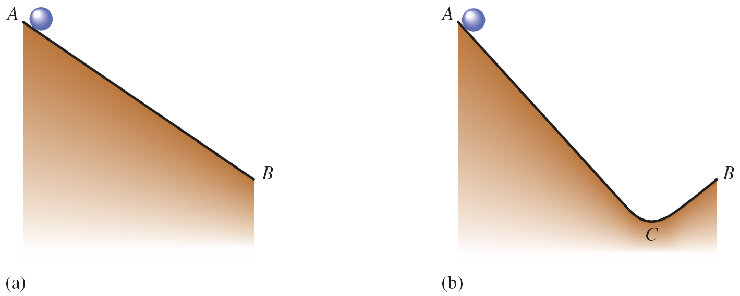
The Meaning of ΔG for a Chemical Reaction
A system can achieve the lowest possible free energy by going to equilibrium, not by going to completion.

Slide 61
Free Energy and Pressure
G = G° + RT ln(P)
or
ΔG = ΔG° + RT ln(Q)

Slide 62
The equilibrium point occurs at the lowest value of free energy available to the reaction system.
ΔG = 0 = ΔG° + RT ln(K)
ΔG° = –RT ln(K) *on formula sheet

Slide 63
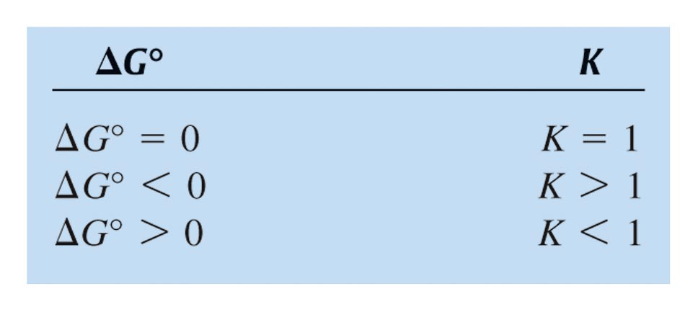
Qualitative Relationship Between the Change in Standard Free Energy and the Equilibrium Constant for a Given Reaction

Slide 64
Gibbs Free Energy and Chemical Equilibrium
ΔG = ΔG0 + RT lnQ
R is the gas constant (8.314 J/K•mol)
T is the absolute temperature (K)
Q is the reaction quotient
At Equilibrium
ΔG = 0
Q = K
0 = ΔG0 + RT lnK
ΔG0 = − RT lnK
18.6

Slide 65
Clausius–Clapeyron Equation
P_{vap} = vapor pressure
ΔH_{vap} = enthalpy of vaporization
R = 8.3145 J/K·mol
T = temperature (in kelvin)

Slide 66
Concept Check
The vapor pressure of water at 25°C is 23.8 torr, and the heat of vaporization of water at 25°C is 43.9 kJ/mol. Calculate the vapor pressure of water at 65°C.
194 torr
Notes:
ln(23.8 torr/P_{vap,T2}) = [(43900 J/mol)/(8.3145 J/K·mol)][(1/338 K) – (1/298)]
P_{vap,T2} = 194 torr

